Slide 1
Domestic violence important considerations for advocates, health care workers, and community members when working with Asian pacific islander & middle eastern communities
Vinder Lallian, MA, LMFT
Licensed Marriage and Family Therapist, MFC#52026
Counseling Director for My Sister’s House
Certified Clinical Trauma Professional (CCTP)

Slide 2
today
Learn about the different types of domestic violence
Identify and discuss cultural considerations when working with the Asian Pacific Islander (API) and Middle Eastern (ME) communities
Do’s and Do Not’s of how to support a possible victim of DV
Red flags in a health care setting
Resources

Slide 3
disclaimers
Victims and abusers can be of any gender, sexual orientation, race or religion
Victim and survivor are terms that I may use interchangeably
For today’s presentation, I will use pronouns she/her for the victim and him/he for the abuser.
Clients may have different feelings that come up for them around both of those words, so we can adjust according to what they want/need/say
This is a very difficult topic
You may be triggered so please do take care of yourself during and after the presentation

Slide 4
What is domestic violence (DV)
Intimate partner violence (IPV)- simply is domestic violence that is happening within a romantic/intimate relationship with a partner, spouse, or ex-partner regardless of sexuality.
Domestic violence – any type aggression/violence that is occurring within a domestic (home) environment. This includes IPV
When working with the API/ME communities, we notice that both of these types of situations are happening. Often, society does not consider verbal abuse and threats coming from a mother-in-law as domestic violence. However, we know than be more common in these communities.

Slide 5
Physical abuse
GOAL: Instill FEAR and maintain POWER & CONTROL
Hitting
Kicking
Slapping
Spitting
Pulling hair
Strangulation
Not allowing one to leave
Using restraints

Slide 6
Verbal abuse
GOAL: Break down the self-esteem of the victim
Name-calling
Making negative comments
Judgmental
Critical
Negativity
Not what they are saying, but the message that is being sent

Slide 7
Sexual abuse
GOAL: Instill FEAR and maintain POWER & CONTROL
Non consensual sexual touch
Forced sexual engagement
Consequences if you do not comply
Participating on to avoid other types of abuse
If you don’t do X, then I will go get it elsewhere threats
Sex trafficking
Forced to use drugs/alcohol before sex
Not allowing use of birth control
Forced pregnancy

Slide 8
What is sexual assault
Sexual assault can take many different forms
Any unwanted sexual advances or touch
Rape, penetration of the victim’s body
Note that sexual assault does not mean only rape. Rape is just one form of sexual assault
Force or coercion to perform sexual acts. Force is not always physical. It can be verbal, emotional and mental

Slide 9
Mental abuse
GOAL: Victim is CRAZY
Victim may become confused
Victim may start to self doubt and have trouble identifying what is reality
Abusers tells the victim that she is crazy
If not physical abuse, comments that she is not a victim since he is not touching her
Mental health struggles (Depression and Anxiety)
Charming in front of others but abusive to you
Isolation leads to struggling in so many ways
Jealousy and control

Slide 10
Emotional abuse
GOAL: Break down SELF-ESTEEM and DISEMPOWER
All the different types of domestic violence are all a form of emotional abuse
Not feeling safe
Living in fear
Feeling unwanted
Feeling unworthy
Feeling confused
Accusations of being unfaithful
Long lasting effects

Slide 11
Financial abuse
GOAL: Maintain POWER and DEPENDENCY on abuser
Not allowing victim to work
Not allowing any freedom to spend
Allowance given
Receipts collected
Forcing victim to work but not allowing access to money
Only allowed to purchase with approval of abuser

Slide 12
Spiritual abuse
GOAL: Break down the SPIRIT, take away HOPE/JOY and COPING
Not allowing or supporting you to practice your religion
Not allowing or supporting you to practice cultural rituals
Making negative comments
Not participating
Not allowing children to participate
Forcing the victim to convert religions
Not allowing victim to go to mosque/temple/gurudwara

Slide 13
isolation
#1 tool of the abuser
Creates dependency
Allows and sets the stage for brainwashing
Increases dependency on the abuser
Decreases independence
Control access to knowledge and resources
Reduces support system for the victim
Examples: he doesn’t like her family, does not allow her to talk to family, control who she talk to, talks negatively about her friends. Eventually she pulls away

Slide 14
strangulation
Any external pressure to the neck by any means that blocks airflow or blood flow
Most lethal form of violence
Often victims say “choke”
Men who strangle are killers
Research indicates that stranglers are very likely to become stalkers
Link to police shooting, mass shooting, etc.
Takes only 2 seconds to go into unconsciousness
Men who strangles are more like to abuse animals and be sexually abusive
Victims of strangulation are linked to higher rates of suicide due to a loss of hope
Reference is www.strangulationtrainininginstitute.com

Slide 15
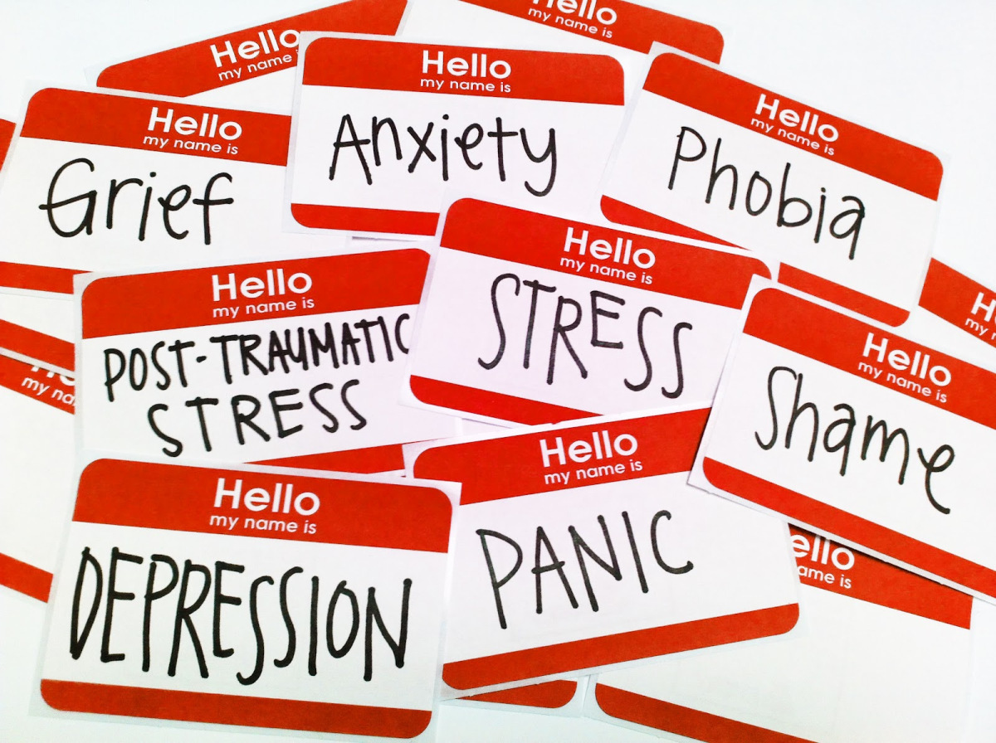
Long-term and Short-term effects of domestic violence
Depression
Anxiety
Post-Traumatic Stress Disorder
Substance Use
Isolation
Lack of resources
Physical symptoms for API/ME

Slide 16
Cultural considerations
What do you think of when you think of domestic violence?
Is there a word(s) for domestic violence in your language if other than English?
What are some assumptions or myths about domestic violence in API/ME cultures?
Is domestic violence normal or expected within the API/ME community?
Does your culture/religion consider one to be a victim of DV without physical abuse?

Slide 17
Role of culture
Gender stereotypes
Patriarchal culture
Victim blaming
Shame
Collectivistic vs. Individualistic approach

Slide 18
Impact of children
Very big reason by API/ME communities want to stay together
Victims think they are sacrificing for the well being of their family
Threats in the family about what they will do with the children
Abusers may tell children that their mother is selfish or wants to take the children away
Parental alienation
Children are the most important even though the domestic violence is damaging the them
Example of Hmong culture

Slide 19
immigration
Key piece of the puzzle for many API/ME victims
Immigration status
No work permit
Do not allow for immigration process, some excuse always
Fear induction
“Go ahead and call the police, you will get deported”
Language barriers
New immigrants do not have the knowledge about the U.S. and the laws

Slide 20
Safety planning
Stay calm
Start working towards a plan
If the victim has a good plan, the victim will be more successful
Victims are at the greatest risk when the leave
Documents, important information, must all be slowing collected, copied, etc. before making a plan to leave
Once victim leaves, she is essentially escaping
DO NOT communicate with the abuser

Slide 21
Do’s and do not’s
Slow down
Victim is the expert
Remind the victim that she does not have to do anything she is not ready to do
Do not judge
Do not pressure
Safety plan
Remind them about the facts you learned about children growing up in a home with domestic violence
Very important that as the victim plans to leave, she has to be careful that he/they do not find out
Do not assume that she wants an advocate that is of the same culture
Every victim and every situation is different
Must make a rational/logical decision and not an emotional decision

Slide 22
Meet them where they are
They may not know they are a victim
Provide resources in a subtle and safe way
Validate their feelings
Listen
Victims are the experts in their own life
Provide education about healthy relationship
Provide education around laws and resources (she may be very misinformed)
Provide as much education around isolation and why isolation is dangerous

Slide 23
Red flags in health care settings
Is the patient quite?
Does the partner/spouse/family member speak for the patient
Does the patient’s spouse/family member refuse to wait in the waiting room
Does the patient have physical injuries that may not align with the “story.”
Does the patient describe chronic pain, headaches, nausea, etc.
Inquire about social well-being (friends, parents, etc)
Isolation is the #1 tool of the abuser (access to support)
Have resources available including a business card that you can discretely give to the potential victim.
Medical decisions should be confirmed by using an interpreter

Slide 24
What to do
If patient requires an interpreter, get one
Request interpreter if support person is “speaking for the client.”
Do not rely on the person with her
Tell the spouse/family member that you’d like to assess the client privately
Does the patient understand the treatment etc. (abortion example)
Do not use words like “domestic violence” because patient may not know what that is.
Ask for example “Do you feel safe at home? Is any one hurting you?”
Watch for non verbal communication and emotion or avoidance.
Head down, refusing eye contact, looking afraid

Slide 25
Resources and services
Utilize and encourage the use of interpreters
Work on breaking down the mental health stigma
Describe therapy or counseling in a way that describes it truly for what it is
I always say, “Just try one session.”
Groups can be a very supportive environment but it there can also be shame and fear
Every client is different
Do not instill fear, rather validate and support
Praise and encourage since self esteem may be negatively impacted by DV

Slide 26
RESOURCES
My Sister’s House website to learn more: www.my-sisters-house.org
My Sister’s House 24/7 multilingual line : 916-428-3271
Domestic Violence Education and Support group
Women to Work program in English and Spanish
Healing thru Art
National Suicide Prevention Hotline is 800-273-8255
Rape, Abuse & Incest National Network (RAINN) www.rainn.org
Strangulation resources www.strangulationtraininginstitute.com

Slide 27
Please contact me directly with any questions at vlallian@my-sisters-house.org

