Slide 1
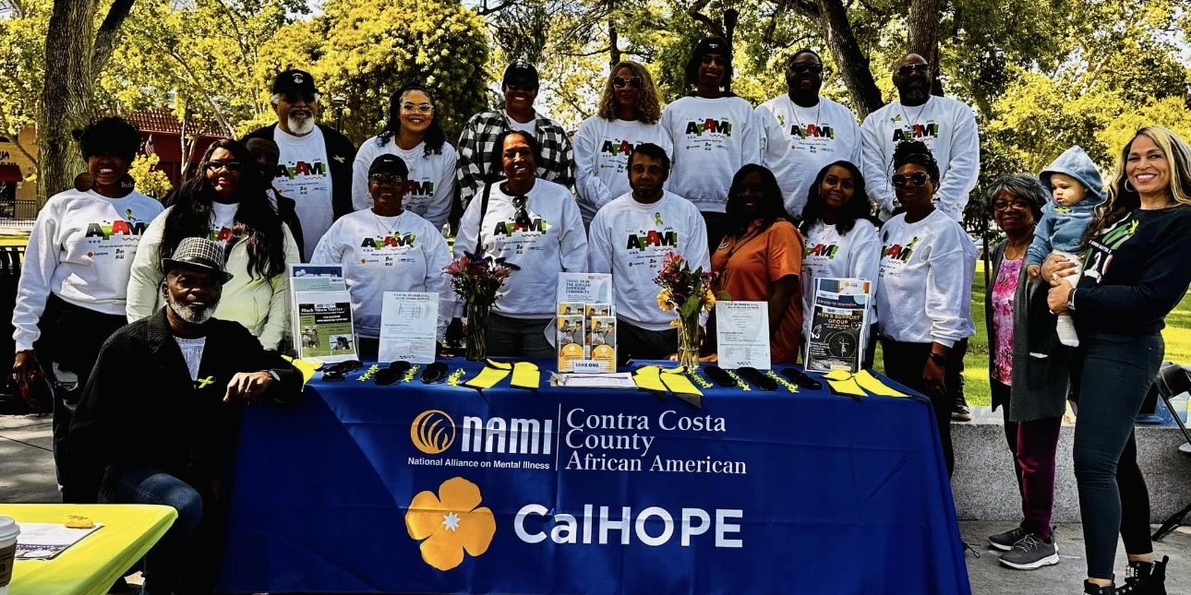

Black Minds Matter 2!
African American Mental Health Awareness Week: February 11-17
Days of Remembrance: Miles Hall February 15th, Tyrell Wilson March 8th,
& Oscar Grant February 27th in City of Oakland

Slide 2
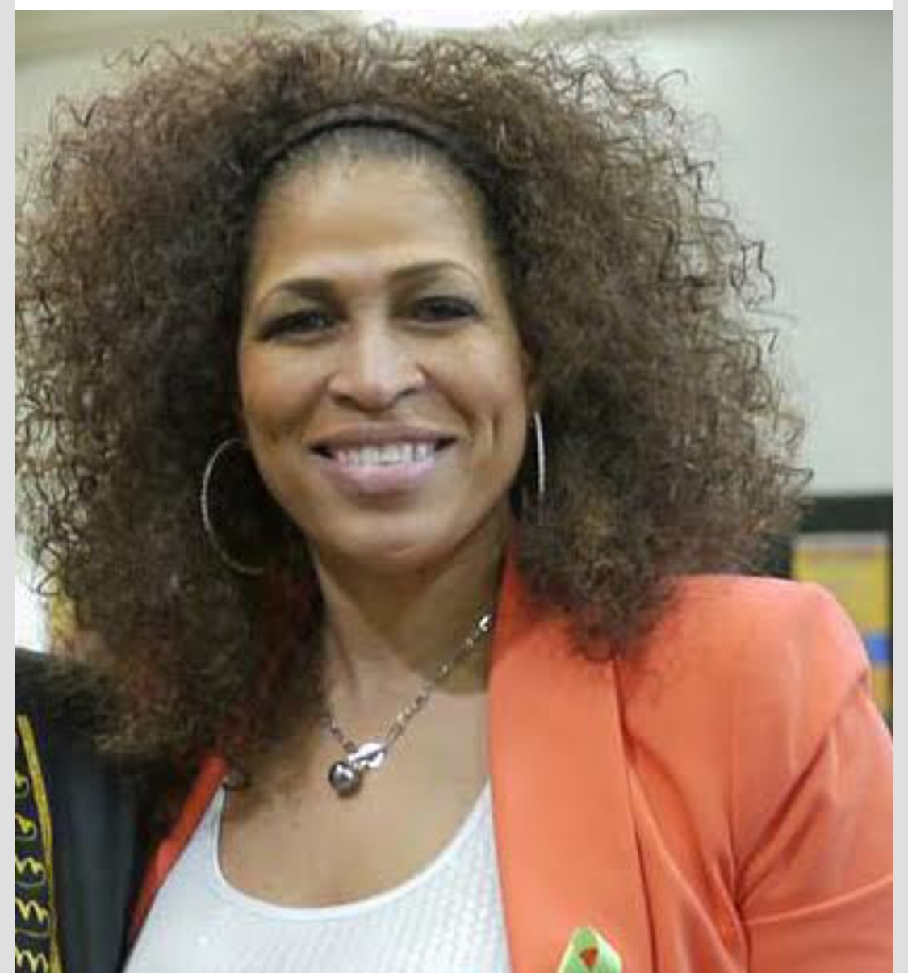
Welcome to a transformACTIONal experience
Gigi R. Crowder, L.E.
Native of Oakland California, Mom of identical 32 years old twin sons. Executive Director of NAMI Contra Costa. Also, Founder of Black Minds Matter 2! Committed to improving health outcomes for individuals and their families impacted by mental illness. 2024 Primary focus supporting efforts to promote African American Holistic Wellness and Resource Hubs throughout the nation.

Slide 3
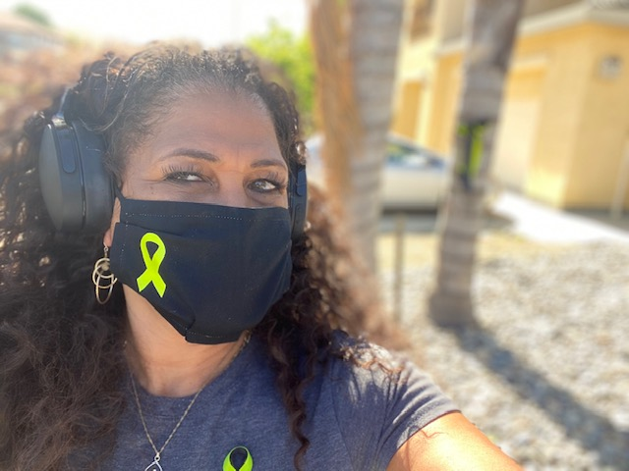
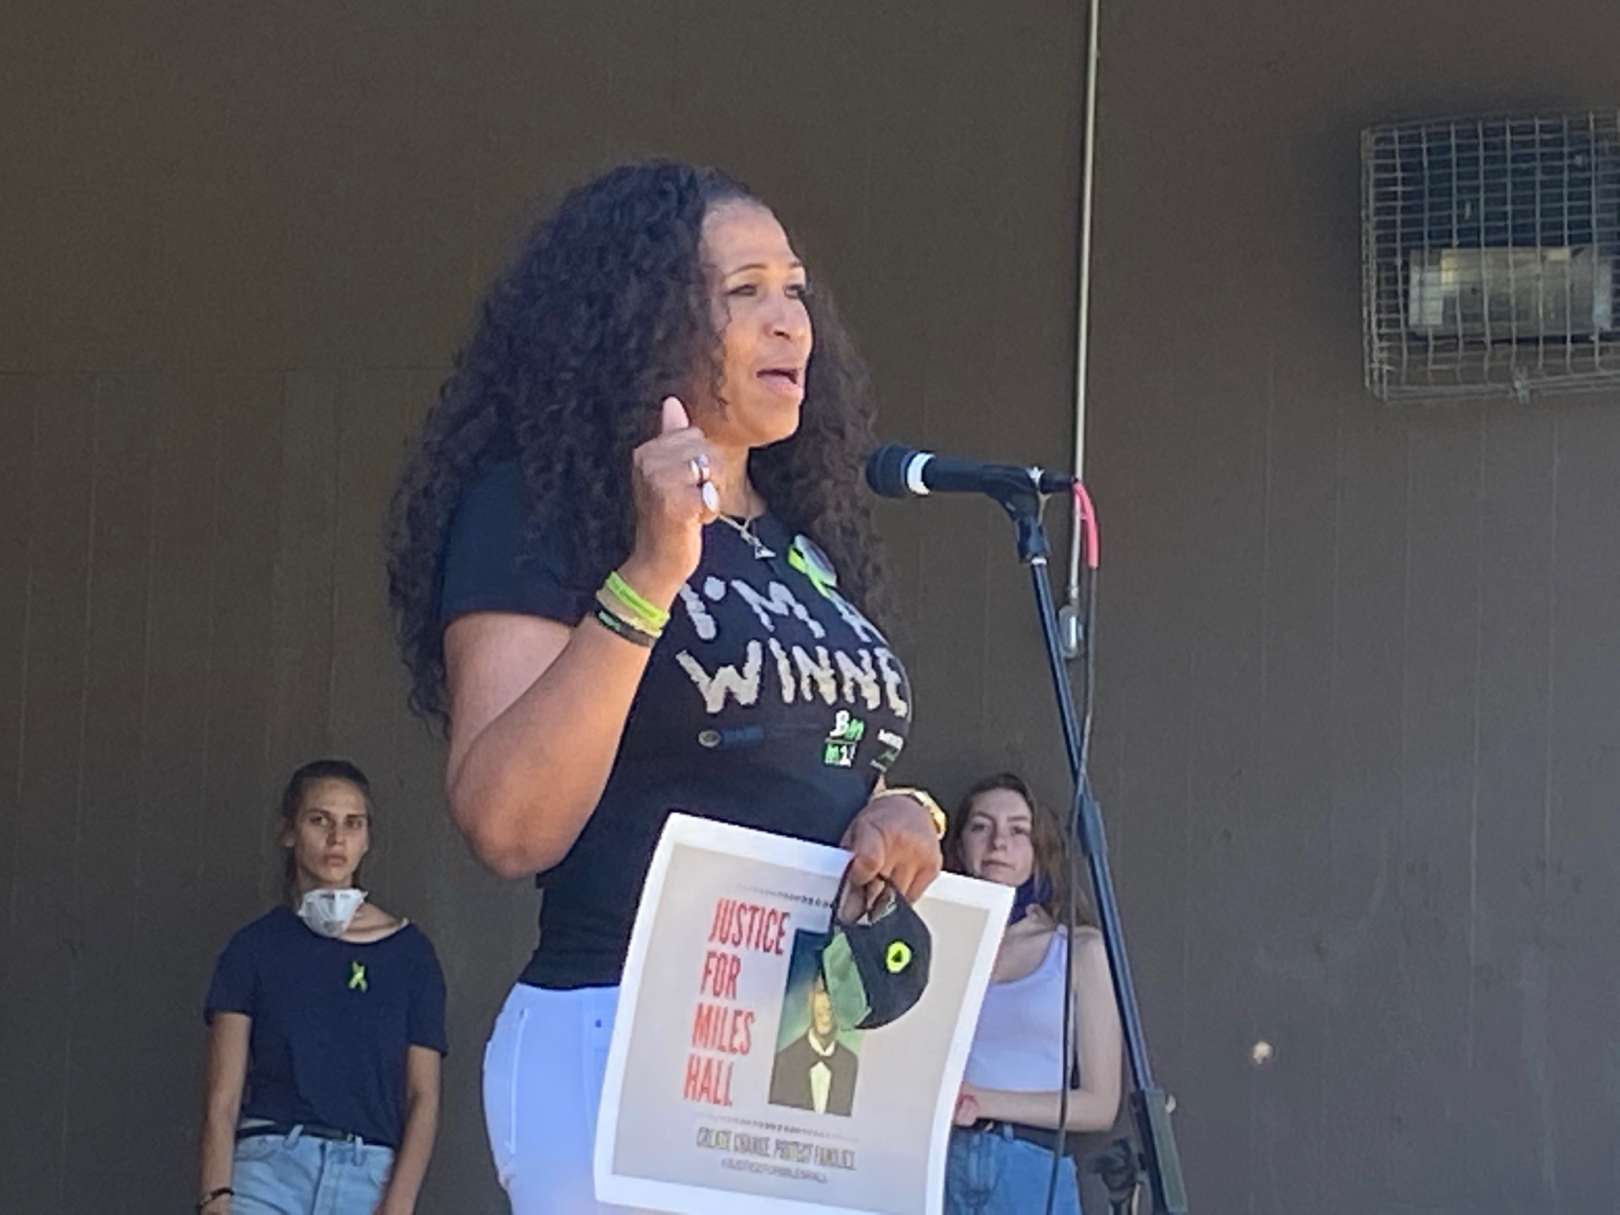
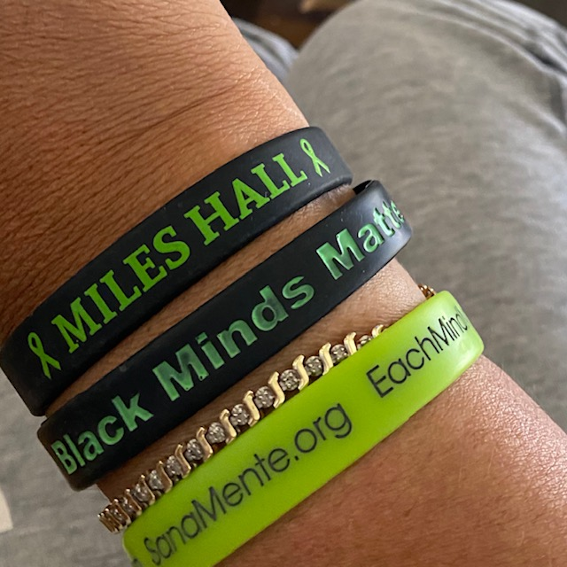
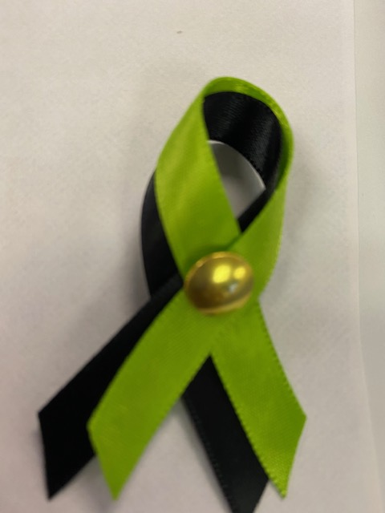
The Birth of Black Minds Matter 2!
Sharing my Story
Notes:
The purpose of ethics is to define acceptable human behavior through knowing the types of actions, its consequences, and the limits of both humans and actions, as well as their acceptability. The basic concepts and fundamental principles of decent human conduct.

Slide 4
“When a Black Mother gives birth to a male child, her sleep is forever compromised!”
Dr. Kenneth V. Hardy, PhD
Consultant at Eikenberg Academy for Social Justice

Slide 5
My Most Recent Experience Advocating for African American Children
We can’t begin to address the issues that will lead to fair practices amongst mental health providers until we come to a point where all providers lead to be racially sensitive which should be followed by racial responsibility.

Slide 6
Peers and Family Member Survey
  Over 2600 respondents
    88% of African-American mental health consumers and family members across California report that spirituality is important to them.
    72% report that they believe it is appropriate for the public mental health system to address spirituality as a part of mental health care.
    89% reported that they regularly used prayer as a wellness tool

Slide 7
African American Family Support Group
  Largely attended by mothers.
  Many of whose children are criminal justice involved.
  Most of the parents in the group share a similar burden which is, feeling like the mental health system and providers can’t relate to the cultural needs of their children and discount the trauma and further impact of dealing with a one-size-fits-all Western paradigm that has often devalued the opinions of families.

Slide 8
MHFC Signature Trainings
  Mental Health 101 for African Americans
  Spirituality 101 – Provider Training
  “I’m A Winner” Every Child needs an IEP
  Keepers of the Flock – Faith Leader Training
  A Bridge Over Troubled Waters

Slide 9
A Mental Health Friendly Provider is…
…A Provider committed to eliminating stigma and improving outcomes for African American Peers/Patients and family members through utilizing culturally responsive practices/approaches that create a sense of belonging and inclusion in all facets of it’s treatment models and programs.

Slide 10



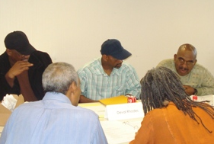


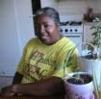
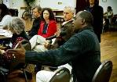



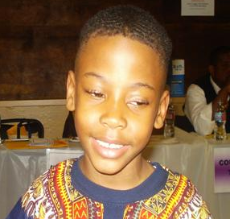
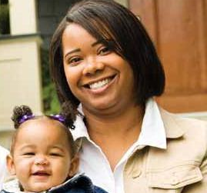



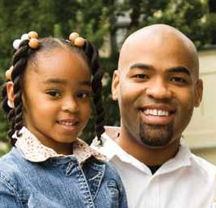

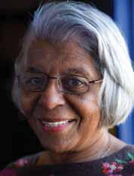
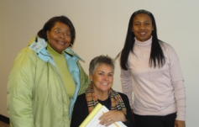




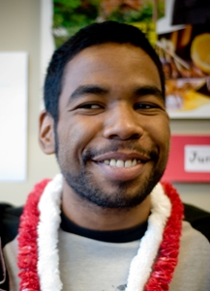
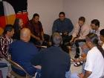
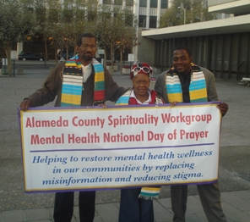


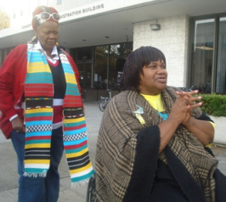


African American Utilization Report
Notes:
Alameda County has historically served African Americans for behavioral health issues at a disproportionately higher rate than other members of our community, yet the outcomes are inconsistent.
In late 2009, BHCS commissioned this study to address and explore the myriad issues affecting behavioral health care services in Alameda County specifically within the African American community.
The process elicited input from a full spectrum of community stakeholders and subject matter experts to identify ways to resolve these disparity issues and deliver more effective, culturally appropriate care.

Slide 11

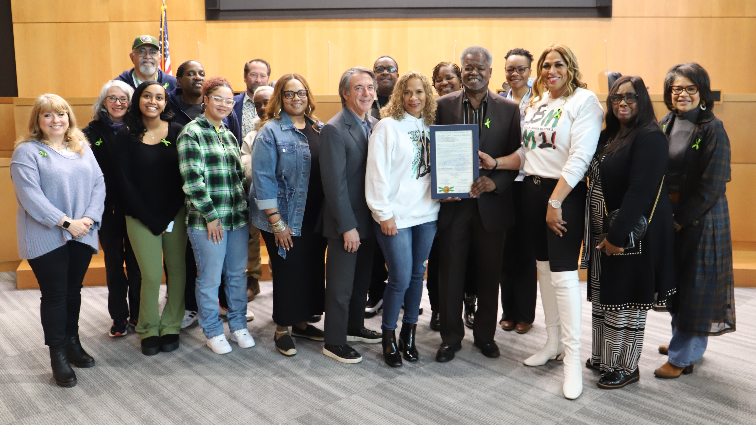
Purpose
Identify issues and concerns surrounding mental health and substance abuse services in the African American community
Provide recommendations to make services more effective and culturally appropriate
Support Alameda County’s Strategic Vision within local/state/federal budget realities
Notes:
Behavioral health care is not a one-size-fits-all system. Voter-mandated MHSA funding enabled us to begin addressing how we deliver and measure our services and improve outcomes in the African American community. The intent of this report is to:
Put all of the issues and concerns about mental health services in the African American community out on the table—many of which are not easy to discuss. But we knew we could not come up with effective solutions if we were not completely clear and transparent about the challenges facing us—societal, historical, and financial.
2. Come up with concrete, realistic recommendations to make mental health and substance use diagnoses, treatment and recovery more effective and respectful of an individual’s age, background and cultural identity.
3. Ensure broad community participation in the process - across socio-economic, demographic and geographic boundaries – and educate and enlist the African American community for long-term interest and involvement.

Slide 12
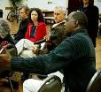



Issues Addressed
Biased and inaccurate diagnoses
Disparities in utilization of services (e.g. over- representation in restrictive, often involuntary, settings), yet inconsistent outcomes
Societal factors: cultural stigma, historical trauma, discrimination
Multiple health care providers; “piecemeal” services; incorrect medications
Need for non-behavioral health community supports
12
Notes:
Regardless of age, the barriers African Americans face in receiving culturally appropriate and effective mental health care are many, among them:
Misdiagnoses, and biases and stigma within the African American community that view mental illness as a personal weakness and “terminal” disease.
Mental health services that are too often forced and/or delivered in restrictive, conflictive places, such as hospitals or jails.
Societal pressures and negative personal experiences that frame how mental illness and substance abuse are viewed by the individual and his or her family.
“One-off” medical services that are delivered by multiple and/or inexperienced clinicians or providers, which can result in conflicting diagnoses, ineffective treatment, dangerous medication, and little or no follow-up.
Too few qualified African American physicians and providers.
To improve outcomes, we must recognize and “treat” the systemic, root causes behind these issues.

Slide 13
The Landscape
Fewer than 4% of social workers and 2% of psychologists and psychiatrists in U.S. are African American (National Association of Black Social Workers)
  Incentive programs for targeted recruitment and professional mentoring
African American students are more likely to be suspended from school then any other at an alarming rate
African American living with mental illness are more likely to be incarcerated
Nationally, 63% of African Americans view depression as a personal weakness (Mental Health America Survey)
Co-occurring diagnoses and “self-medication” affect 70% of all BHCS consumers (BHCS System Data)
Notes:
This slide illustrates the staggering statistics that have historically defined mental health within the African American community both nationally and locally.
[READ STATS]
13

Slide 14
What do all people need to feel good
about themselves and thrive?
Please put your responses in the chat
That’s true for African Americans too!

Slide 15
FACTS: Children & Youth (Birth-Age 16)
Inappropriate diagnoses due to lack of culturally informed medical knowledge
Over-representation in foster care, out-of-home and juvenile justice systems
Child, youth or family often unable to provide historical background or context
SAMHSA issued an Urgent Report: 7/2019
Recent research has shown that Black youth were approximately two times more likely to die by suicide than their White counterparts. Black students also had a higher rate of suicide attempts when compared to their White and Hispanic counterparts.
Today – Suicide is the 3rd cause of death for black males ages 1-19
Notes:
County data suggests that African American children and youth may be inappropriately diagnosed with serious emotional disturbance and serious mental illness—which can be especially stigmatizing and follow the individual through their pivotal development years.
Kids with these complex issues are vastly misrepresented in the foster care, out-of-home and juvenile justice systems. Compounding this, many often receive treatment from numerous providers, most of whom never communicate with the other to share patient history and treatment information.

Slide 16
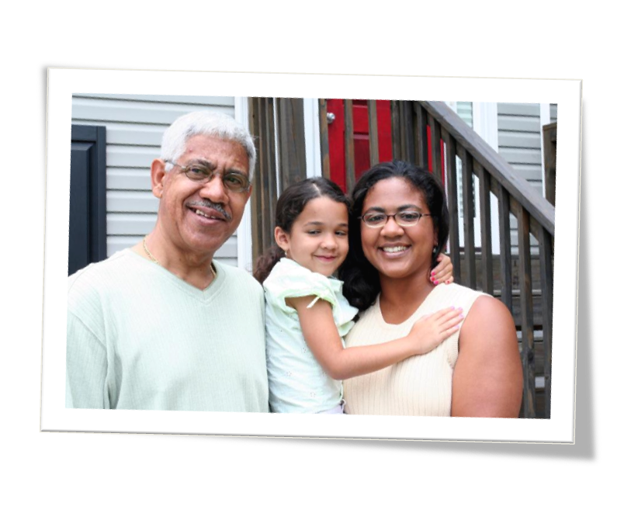
RECOMMENDATIONS: Children and Youth
Promote Clarifying Assessments & community-based consultations
Utilize natural resources such as those found in faith communities
Increase referrals and info-sharing among providers, family and other service agencies
Increase the inclusion of child and family in treatment planning
16
Notes:
The recommendations contained in the report include:
Promote the use of Clarifying Assessments, which evaluate the child in all areas of function and behavior.
Adopt community-based consultations to gain insight from the child’s community and background on “triggers” or other influences.
Work with local schools to integrate CBIT programs.
Build stronger communication channels to share information and resources among the child, family, CBOs, and other service agencies.

Slide 17
Community Defined Strategy:
I Am A Winner!
    Purpose:
      Specific community defined strategies for ages 3-18 years old.
      Empower and equip the African American community to reconnect and heal from within to protect our youth.
      Designed to reduce Mental Health Stigma and Disparities and promote mental wellness using a faith based culturally responsive approach for our most precious commodity by pairing faith centers with local schools.

Slide 18
“I AM A WINNER!”
  Volunteer opportunities for local Seniors
  Reduce stigma by ensuring all students have an IEP, Individualized Empowerment Plan
  STEM vs. HISTEM
  Goal Setting and Rites of Passage

Slide 19
Things to Consider When Working with African Americans
  Parts of this shared cultural experience — family connections, values, expression through spirituality or music, reliance on community and religious networks — are enriching and can be great sources of strength and support.
  However, another part of this shared experience - being subject to racism, discrimination and inequity- can significantly affect a person’s mental health.
  According to the American Psychiatric Association’s Mental Health Facts for African Americans guide, they are also:
    Less likely to receive guideline-consistent care
    Less frequently included in research
    More likely to use emergency rooms or primary care (rather than mental health specialists)

Slide 20
Challenges
  African American of all ages are harmed by a one size fit all system
  Children express depression differently; “I have a stomachache!”
  Diagnosed with external disorders, ADHD, conduct disorders, instead of underlying depression
  Still Face Experiment with babies
  Distance Learning

Slide 21
Opportunities
  Empower school aged children – Affirmations –”I am a Queen - King!” I am a Winner!
  Nurture verses condemning those exposed to trauma – From Trauma Informed Care to Healing Centered Engagement
  Restorative Justice
  Mentoring

Slide 22

What Can You Do Differently Remembering Black Minds Matter 2?!

